Slide 1
Building Your Graphql Server with Prisma
Abraham Nnaji

Slide 2
About
Name: Abraham Nnaji
Work: SkipTheDishes
Twitter: @nnajiabraham

Slide 3
Summary
JavaScript Teaser
Quick Review On GraphQL
Introduction and working with Prisma

Slide 4
JavaScript Teaser
https://repl.it/@AbrahamNnaji/WInnipeg-JS-teaser
https://codesandbox.io/s/xroo830mno
https://gist.github.com/mgechev/4188098

Slide 5
What is GraphQL
New API standard developed by Facebook
Specification for type system & query language
Core primitives: Query, Mutation & Subscription

Slide 6
Why use GraphQL?
Strongly typed schema for your API
Query exactly the data you need
Rich tooling ecosystem & great community

Slide 7
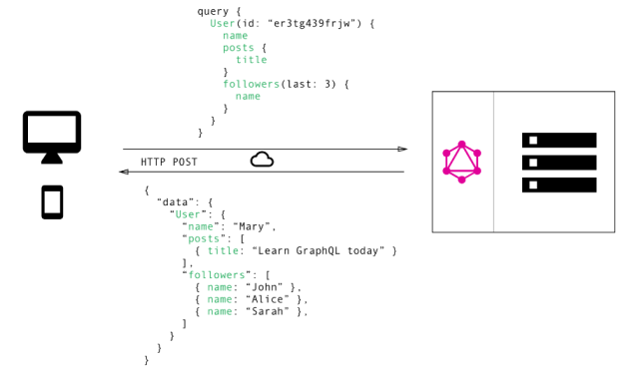

Slide 8
Demo and Learn More
Demo
https://www.graphqlbin.com/v2/6RQ6TM
Resources
http://bit.ly/top-5-reasons-for-graphql
https://www.howtographql.com/basics/0-introduction/

Slide 9
GraphQL Servers

Slide 10
3 main part of a GraphQL server
API definition: Strongly typed & written in GraphQL Schema Definition Language (SDL), Defines API capabilities and has the Special root types: Query, Mutation, Subscription
Resolver Functions: Concrete implementation of the API, One resolver function per field in SDL schema, Query execution: Invoke resolvers for all fields in query
Setup - Framework, Middlewares, Network(HTTP)... : "GraphQL engine" to orchestrate resolver invocations, Network layer based on "graphql-yoga" (network configuration: port, endpoints, CORS ... ), Middleware (analytics, logging, crash reporting ... )

Slide 11
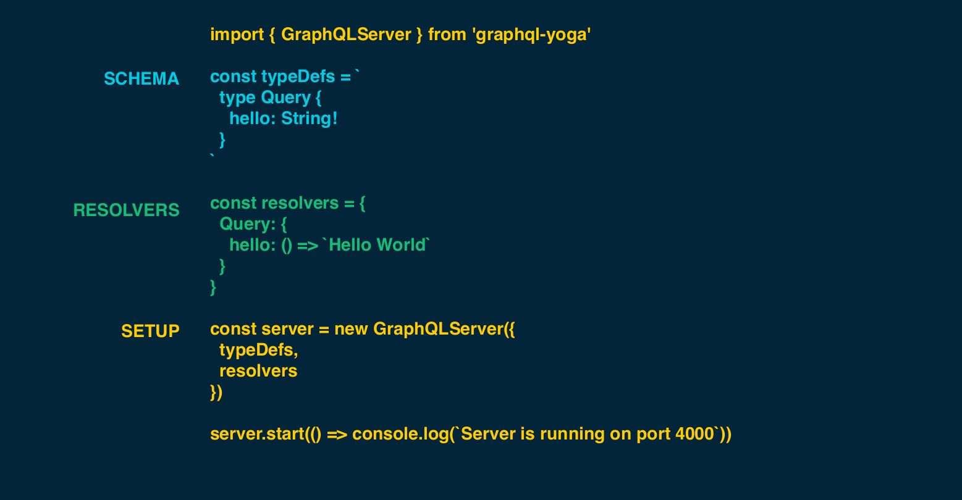
...Putting everything together

Slide 12
Learn More...
GraphQL Server Basics - The Schema
http://bit.ly/graphql-the-schema
GraphQL Server Tutorial
https://www.howtographql.com/graphql-js/0-introduction/

Slide 13
What is Prisma
Strongly-typed access layer for your database (you can call it an ORM on steroids)
Auto-generated and type-safe database client
Declarative data modelling and migrations

Slide 14
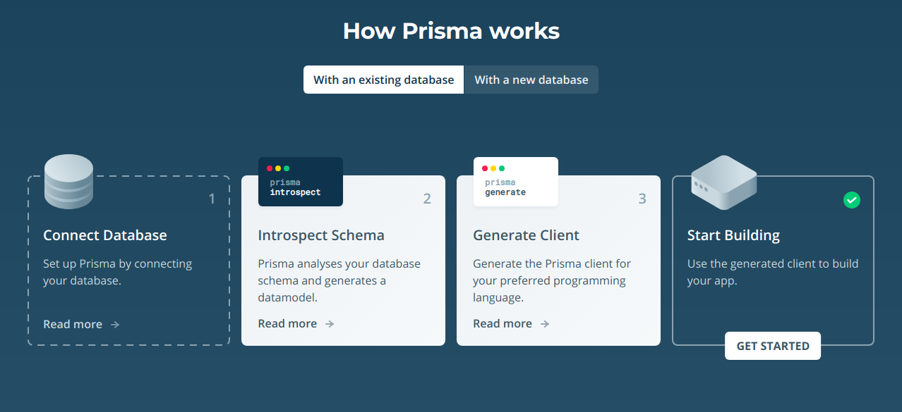
How Prisma works

Slide 15
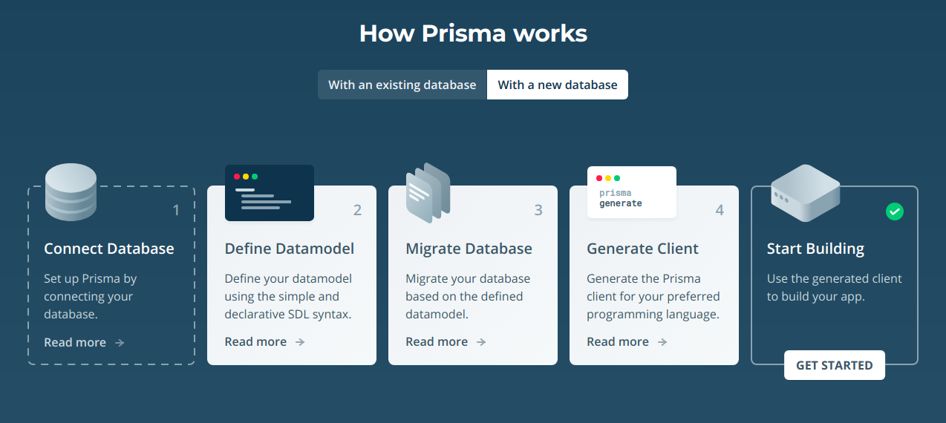
How Prisma works

Slide 16
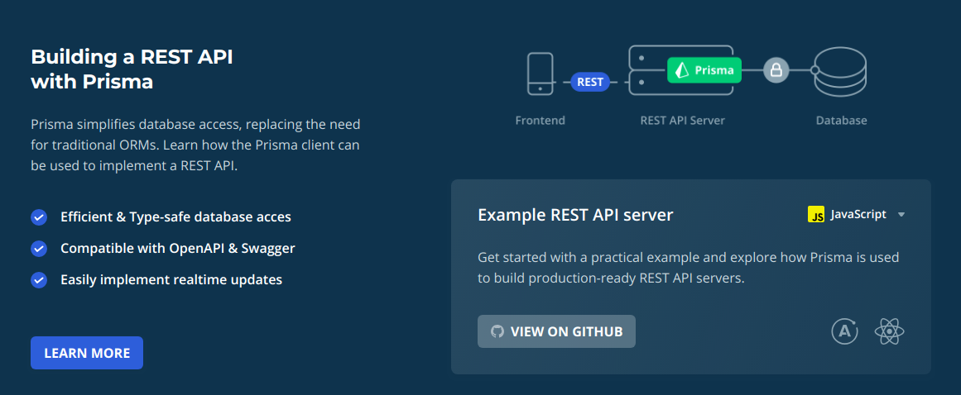
GraphQL Architectures with Prisma

Slide 17
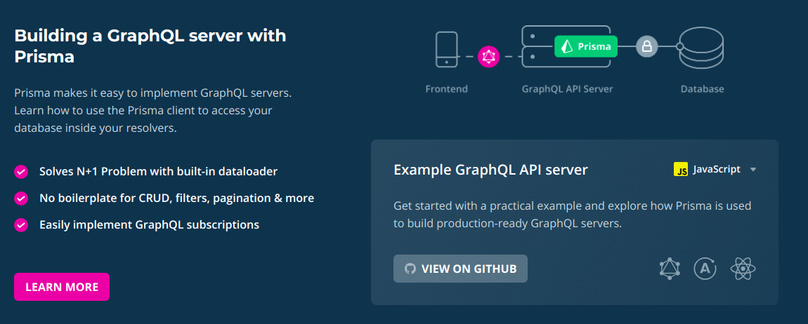
GraphQL Architectures with Prisma

Slide 18
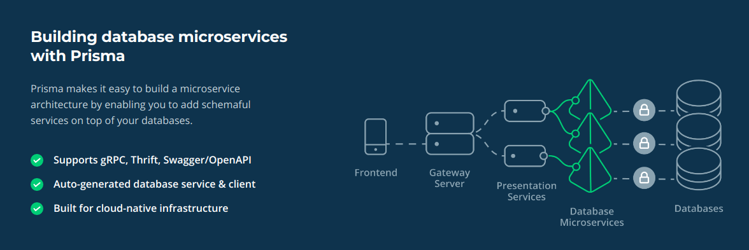
GraphQL Architectures with Prisma

Slide 19
Working with Prisma
Datamodel: Defines the models of your application and is foundation for the Prisma client API. (Optional: Can be used to perform migrations against your database.)
Prisma server: A standalone infrastructure component sitting on top of your database.
Prisma client: An auto-generated library that connects to the Prisma server and lets you read, write and stream data in your database. It is used for data access in your applications.

Slide 20
Demo

Slide 21
My Difficulties with Prisma
It is beyond the scope of an ORM, it pretty much creates an GraphQL API for database hence creating a database as service which you can lock to only your application server. This is all good because you can scale horizontally quickly and add different layers to this endpoint like logging, caching etc.. since it uses docker. Now that is difficult for me cause i had to start learning docker, how its implemented, best practices etc..
Also the type of DB Prisma support but they seem to be really adding support for more db quickly
https://www.prisma.io/forum/t/why-does-prisma-run-in-a-docker-container-instead-of-being-a-simple-library/5962/3

Slide 22

Thank You 🙏
@nnajiabraham

